Slide 1
Data – The Fabric Of Our Lives
Edmonton Microsoft Data Professionals
January 21st, 2025

Slide 2


He / him pronouns
Microsoft Data Platform MVP
MCSE: Data Management and Analytics
Albuquerque data platform group leader
Contact me:
Bluesky: @chrishyde325.bsky.social
Email: chrishyde325@gmail.com
Chris Hyde
Owner and Principal Consultant
Hydrate Consulting, LLC
@chrishyde325.bsky.social

Slide 3
Agenda
“100 level” overview of Microsoft Fabric
Not a deep dive!
OneLake and lakehouse architecture
Discuss the different components of Fabric
Demos for some components intermingled

Slide 4
What is Microsoft Fabric?
Microsoft’s next generation all-in-one data analytics product
Full integration of data warehousing, data engineering, and data science tools into the same portal as Power BI (reporting and data visualization)
Software-as-a-Service (SaaS) rather than Platform-as-a-Service (PaaS)
One copy of data in the integrated OneLake data lake

Slide 5
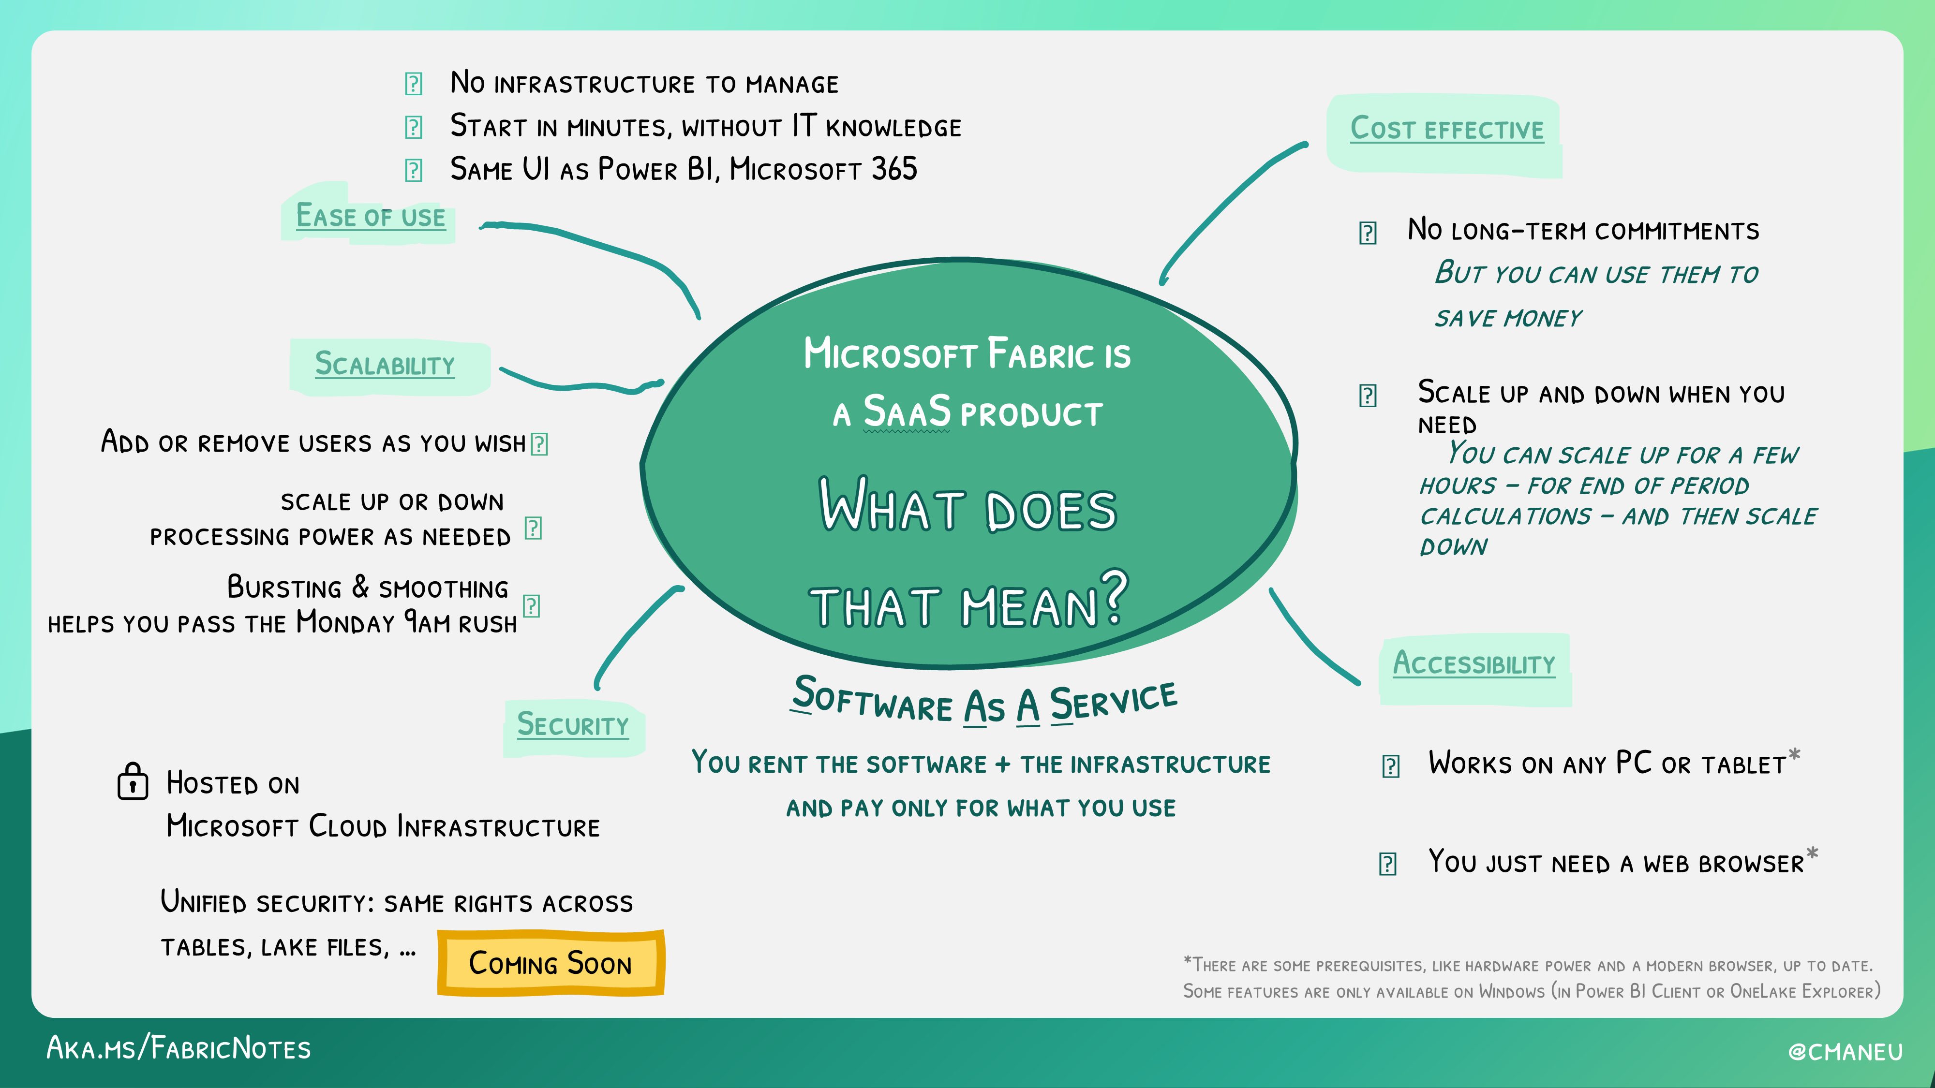

Slide 6
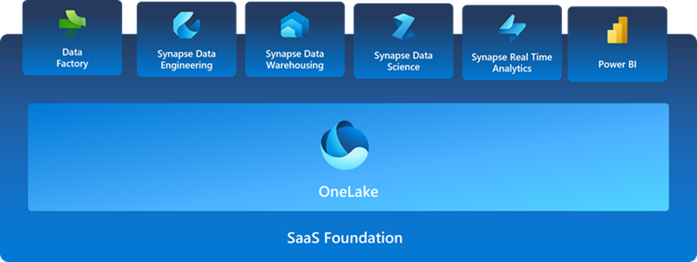
SaaS Foundation

Slide 7
OneLake
“OneDrive for data”
Full compatibility with Azure Data Lake Storage Gen2
Shortcut feature allows data virtualization across other ADLSg2, Amazon S3, and (soon) Google Storage
Data stored in the open-source Delta Parquet format
OneLake file explorer

Slide 8
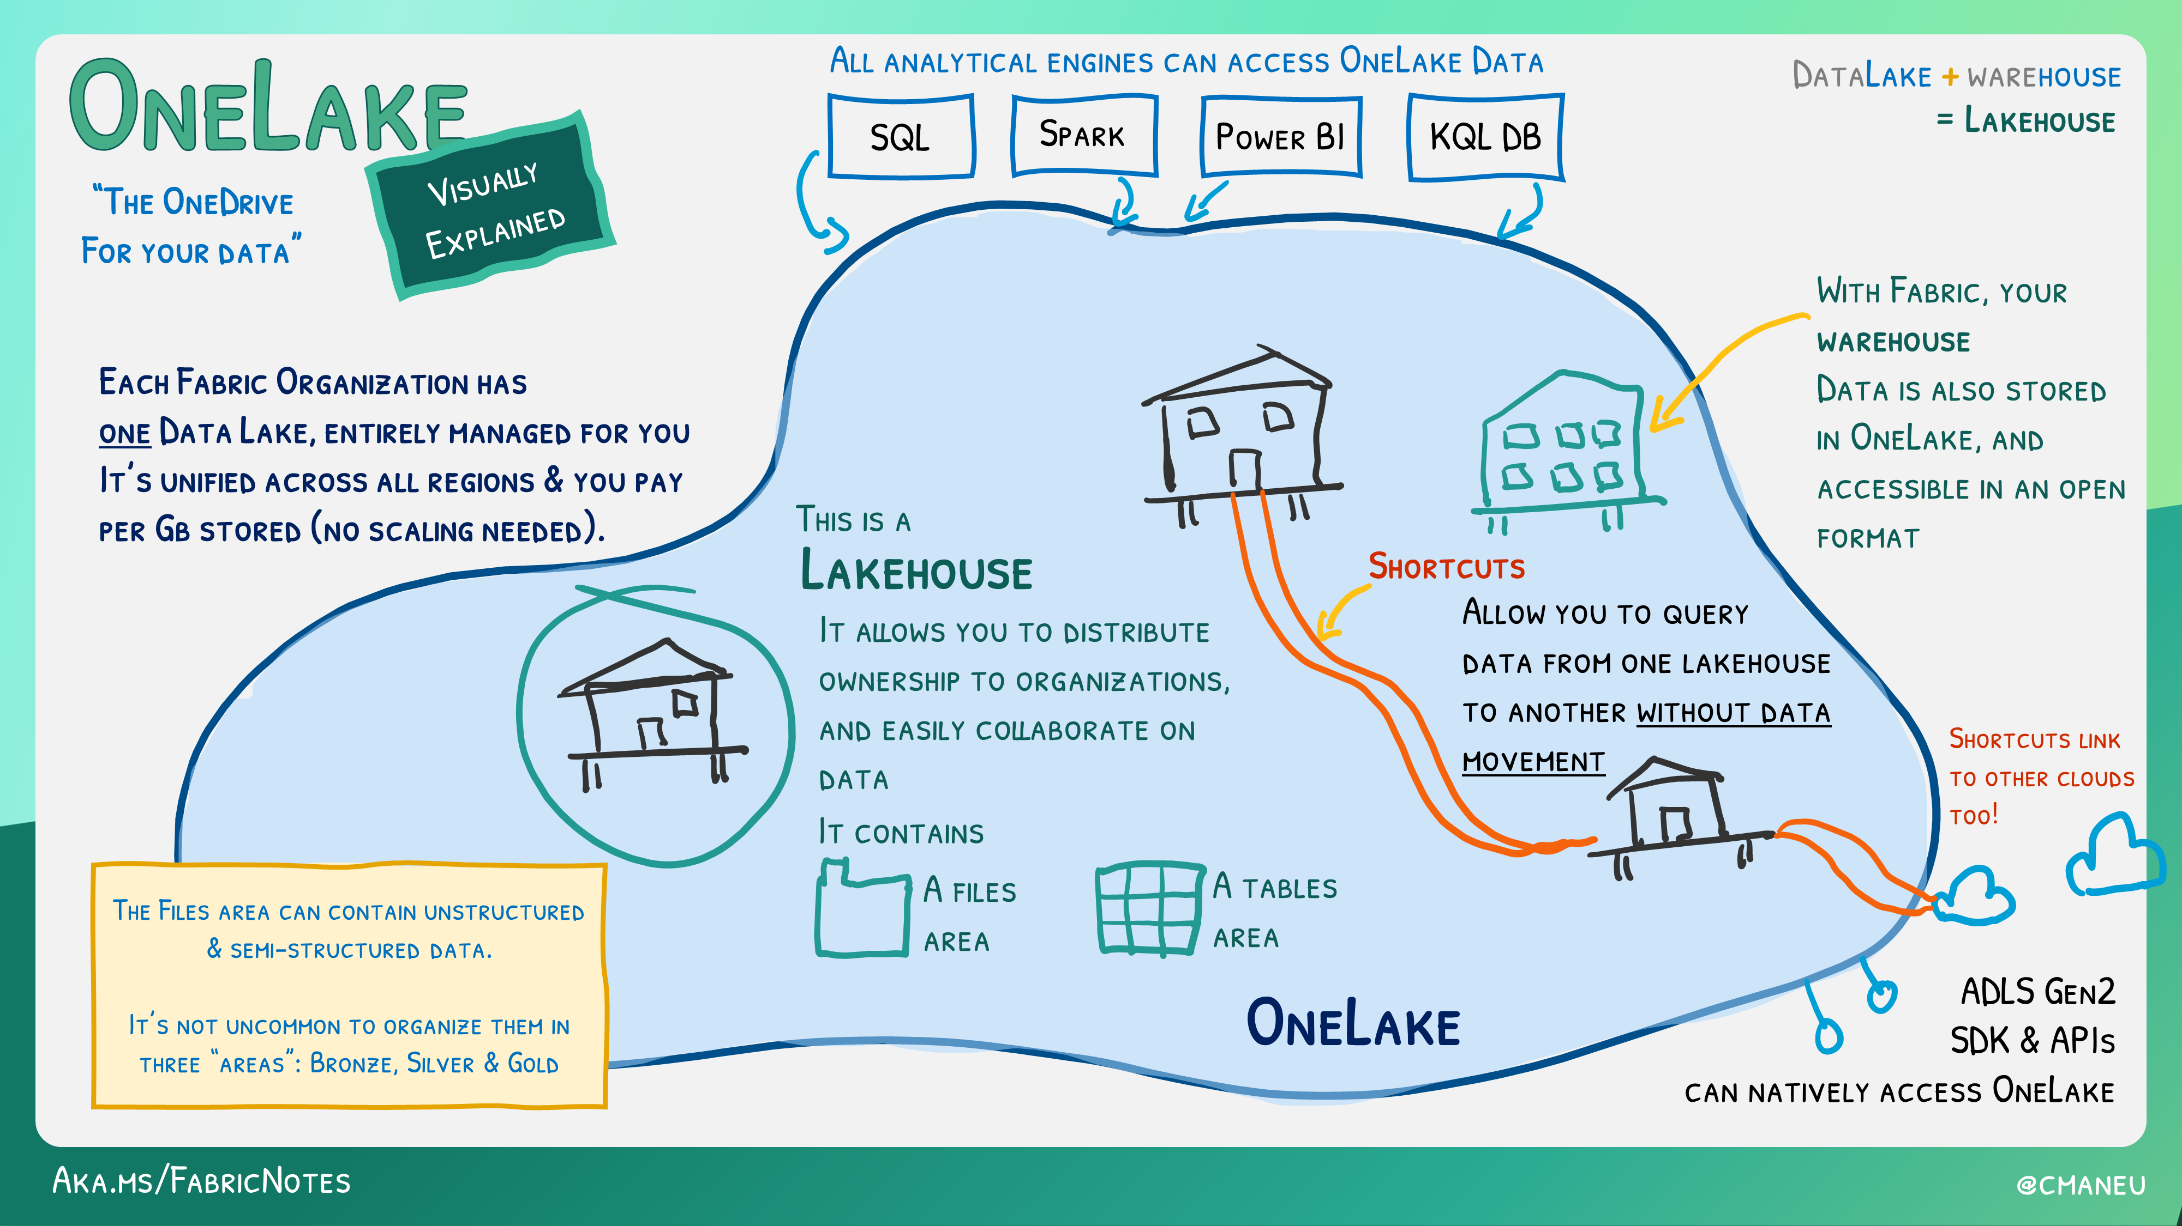

Slide 9
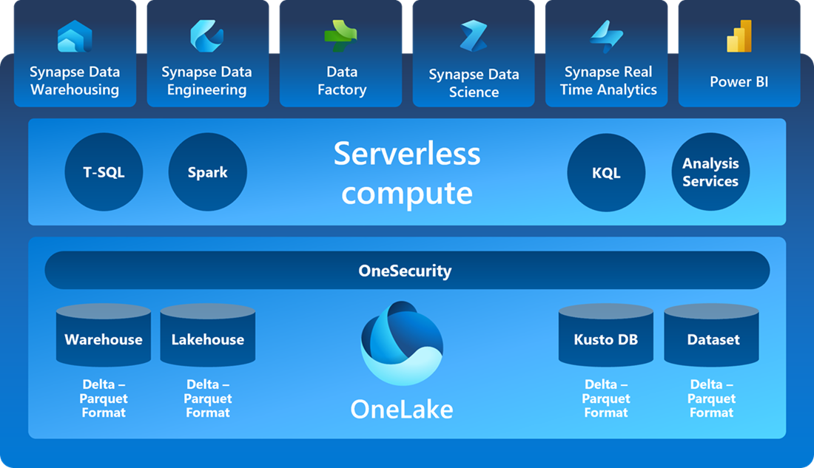
SaaS Foundation, part 2

Slide 10
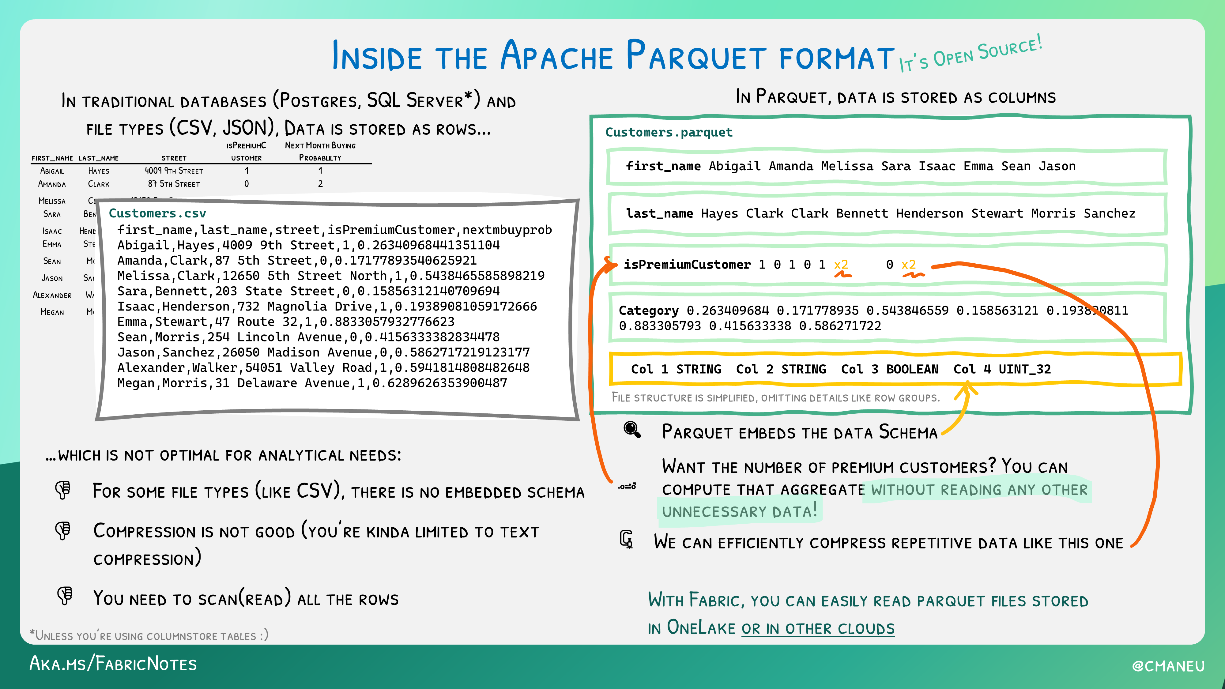

Slide 11
What is a Lakehouse?
“…An open architecture that combines the best elements of data lakes and data warehouses.”
Proposed by Databricks in whitepapers in 2020/2021
10 key features
Often organized in medallion architecture

Slide 12
Key features of a Lakehouse
Transaction (ACID) support
Schema enforcement and governance
Supports BI tools
Storage is de-coupled from Compute
Open standards

Slide 13
More key features
Supports both structured and unstructured data
Supports multiple types of analytics workloads
Real-time streaming data
Security and access control
Data governance and data catalogs

Slide 14
Delta Parquet
Delta layer provides compatibility for ACID transactions, as well as schema drift
All delta is parquet, not all parquet is delta

Slide 15
Medallion architecture
Bronze layer – raw data, staging
Silver layer – cleansed and conformed data, possibly third-normal form (3NF)
Gold layer – curated and transformed, possibly in a star schema
Learn more at: www.databricks.com/glossary/medallion-architecture

Slide 16
Lakehouse Demo
Learn more at: https://learn.microsoft.com/en-us/fabric/data-engineering/lakehouse-overview

Slide 17
Synapse Data Warehouse
More traditional data warehousing experience
Structured data, usually in a star schema relationship (ie. facts and dimension)
Develop primarily with T-SQL; Query with T-SQL code or visual editor
Data is still stored in the open-source Delta Parquet format!

Slide 18
Data Warehouse Demo
Learn more at: https://learn.microsoft.com/en-us/fabric/data-warehouse/data-warehousing

Slide 19
Lakehouse vs. Warehouse?
Structured and unstructured data vs. only structured data
Spark (PySpark, Scala, Spark SQL, etc.) vs. T-SQL
Highly complex data structures and transformations vs. denormalized tabular data
Data scientist and data engineer vs. SQL developer and data analyst
Learn more at: https://youtu.be/cmQ9hs8DdR0

Slide 20
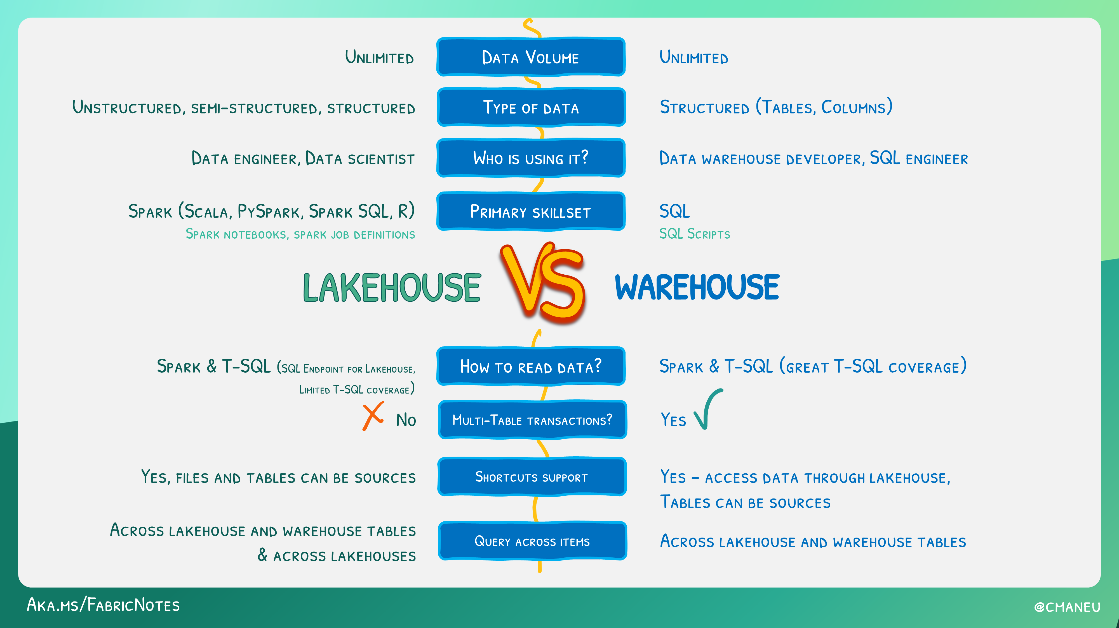
Demo

Slide 21
Synapse Data Science
Notebooks – train models
Experiments – evaluate models
Models – store in the workspace
Learn more at: https://learn.microsoft.com/en-us/fabric/data-science/data-science-overview

Slide 22
Real-Time Analytics
End-to-end streaming solution for high-speed data analysis
Optimized for time-series analysis
Kusto Query Language (KQL) only
Learn more at: https://learn.microsoft.com/en-us/fabric/real-time-analytics/overview

Slide 23
Power BI
Direct Lake mode (diagram next slide)
Many limitations currently in public preview
Limitations detailed at: https://learn.microsoft.com/en-us/power-bi/enterprise/directlake-overview#known-issues-and-limitations

Slide 24
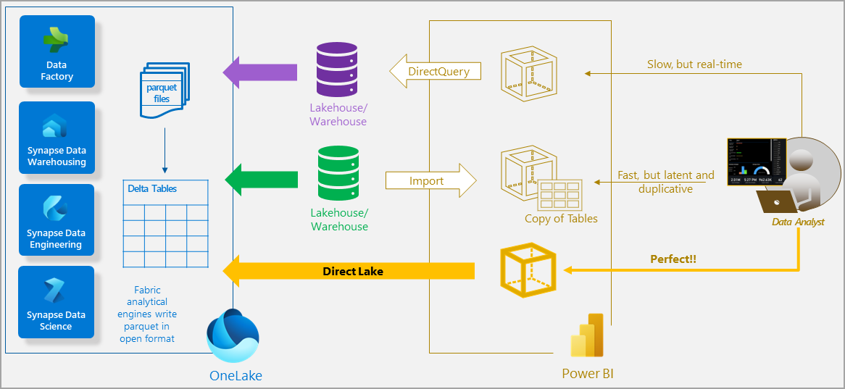
Demo

Slide 25
Power BI Demo
Learn more at: https://learn.microsoft.com/en-us/power-bi/fundamentals/power-bi-overview

Slide 26
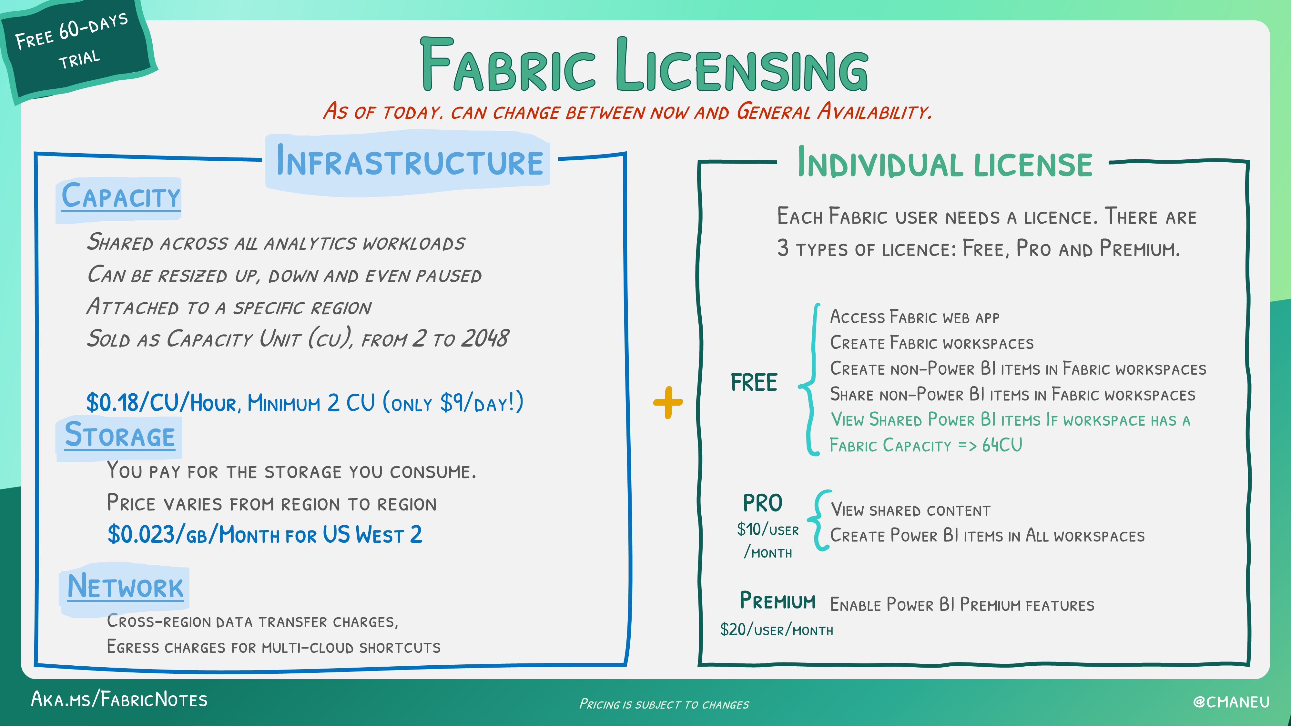

Slide 27
Resources
https://github.com/DrJekyll325/Presentations
azure.microsoft.com/en-us/blog/introducing-microsoft-fabric-data-analytics-for-the-era-of-ai/
learn.microsoft.com/en-us/fabric/get-started/microsoft-fabric-overview
aka.ms/fabric-learn
aka.ms/FabricRoadmap

Slide 28
Video Resources
aka.ms/fabric-webinar-series/
www.youtube.com/watch?v=-f0XIVEP7bE&list=PLv2BtOtLblH1RhbtfTpp9ovi3Y-3HiRO2

